Slide 1


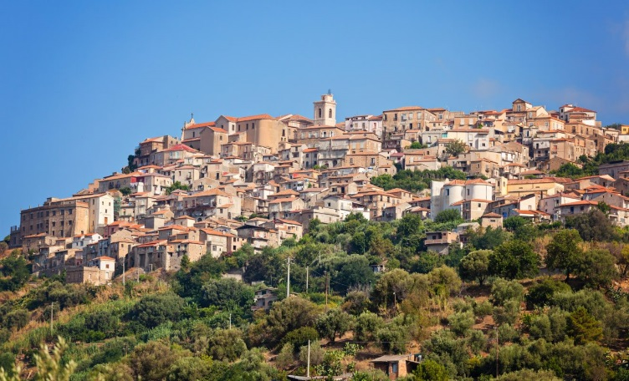

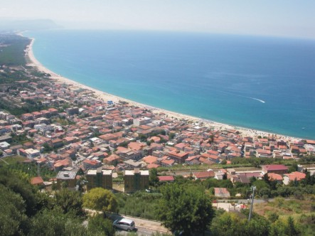
NICOTERA
MAGIC WORLD OF FAIRY TALES
Nicotera is located along the Coast of the Gods, on a panoramic ledge sloping towards the Gulf of Gioia Tauro. The extraordinary heritage of the town includes natural beauties, thousand-year old history, culture and traditions.

Slide 2
A little history of the town
The town, as you can see it now, dates back to the times of Robert Guiscard, who looked for a port that would allow his army, involved in a war against the Arabs in Sicily, to get rapidly to the island. In 1065 he had the town rebuilt on the hill and fortified and repopulated it. Nicotera Marina stands on the coast, near the sea. Some necropoles and Roman hydraulic works were found near Nicotera Marina and Mesima river . The area was also identified by the archaeologists as an emporium that probably served the Greek colony of Medma.

Slide 3
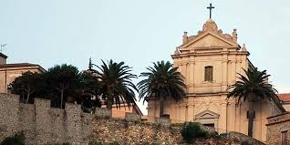
Nicotera is an old town : there is a castle built in 1763 and a Cathedral built in 1785 dedicated to Our Lady of Assumption.

Slide 4
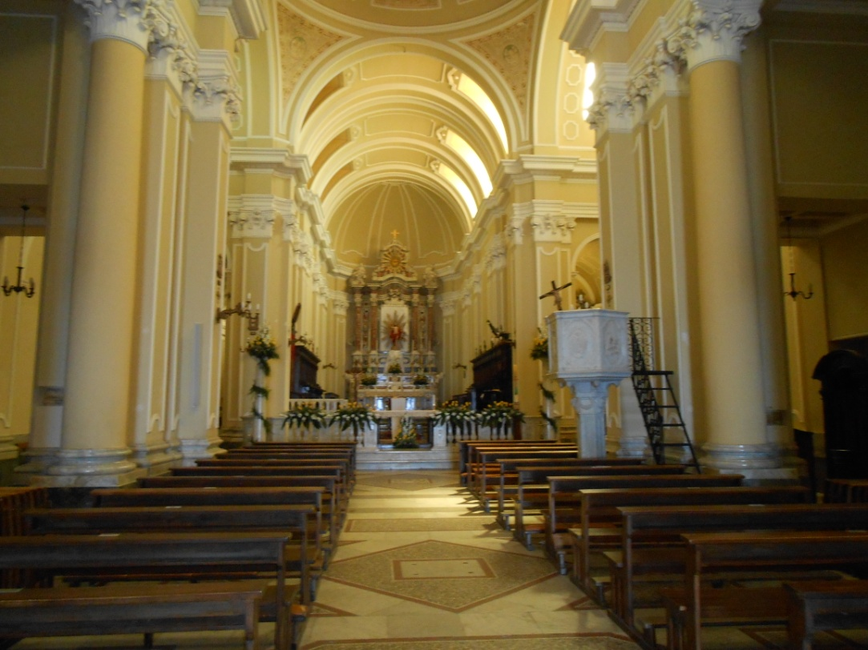
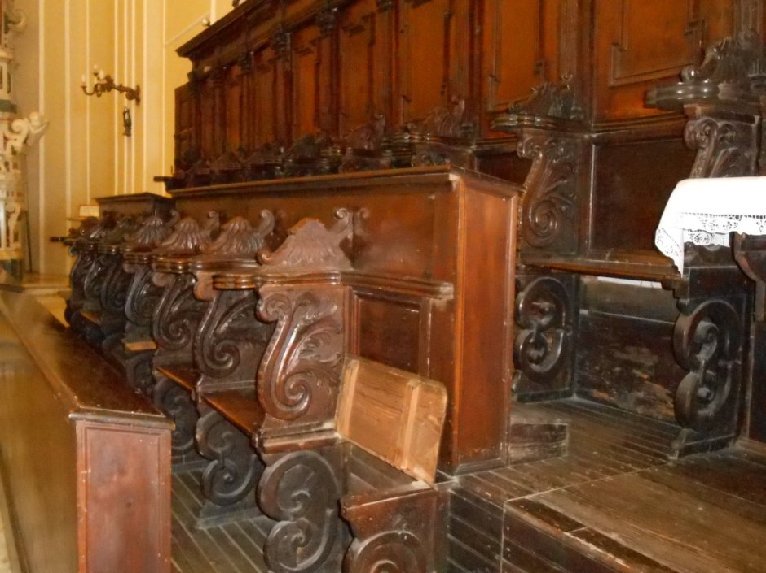
INSIDE THE CATHEDRAL

Slide 5
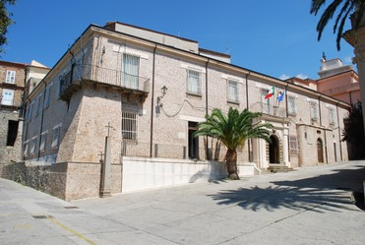
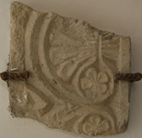
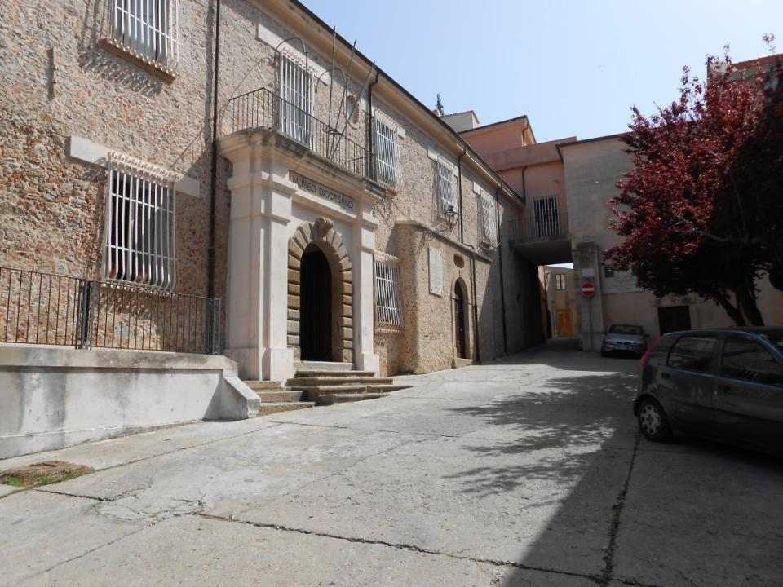
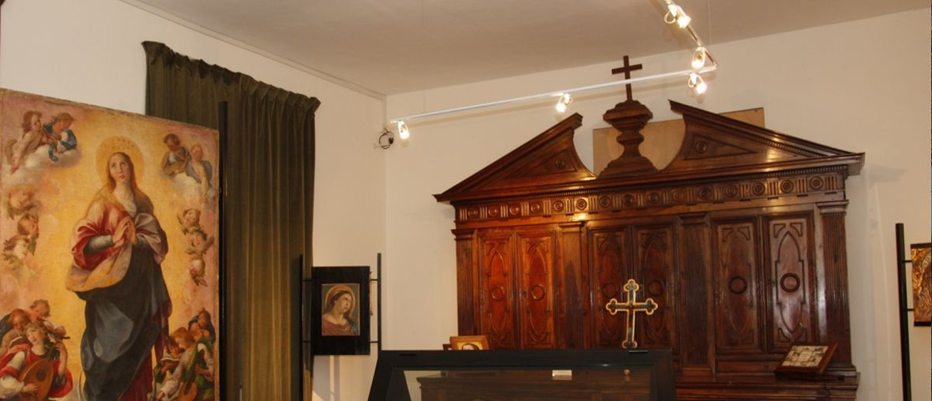
THE SACRED ART MUSEUM IS OPPOSITE THE CATHEDRAL.

Slide 6
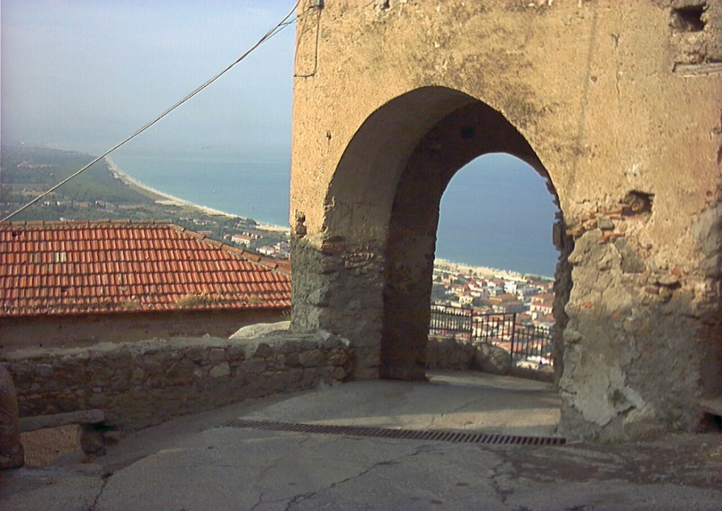
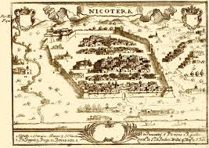
Seven doors all around the ancient walls were the entrance to the medieval town : Porta Grande, Porta Prisca,Porta Palmentieri, Porta Piccola ,Porta di Joppolo, Porta Santa Caterina, Porta Foschea.
There are also archaeological remains dating back to ancient Rome.

Slide 7
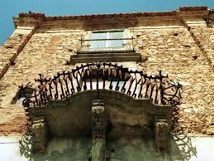
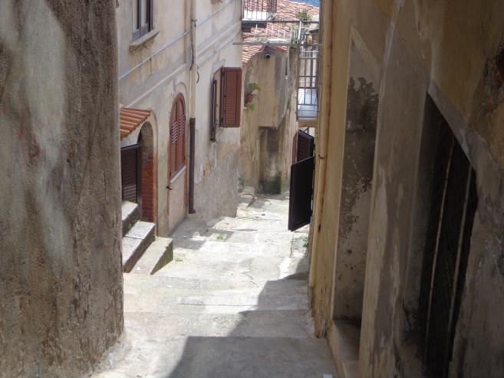
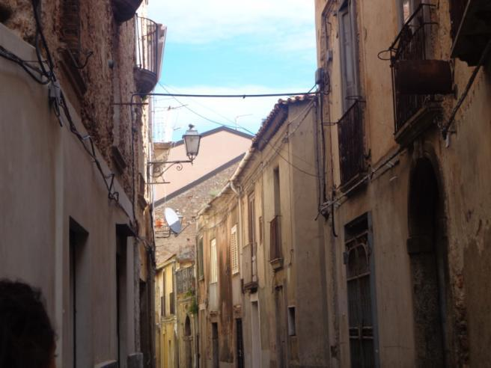
The historical centre

Slide 8
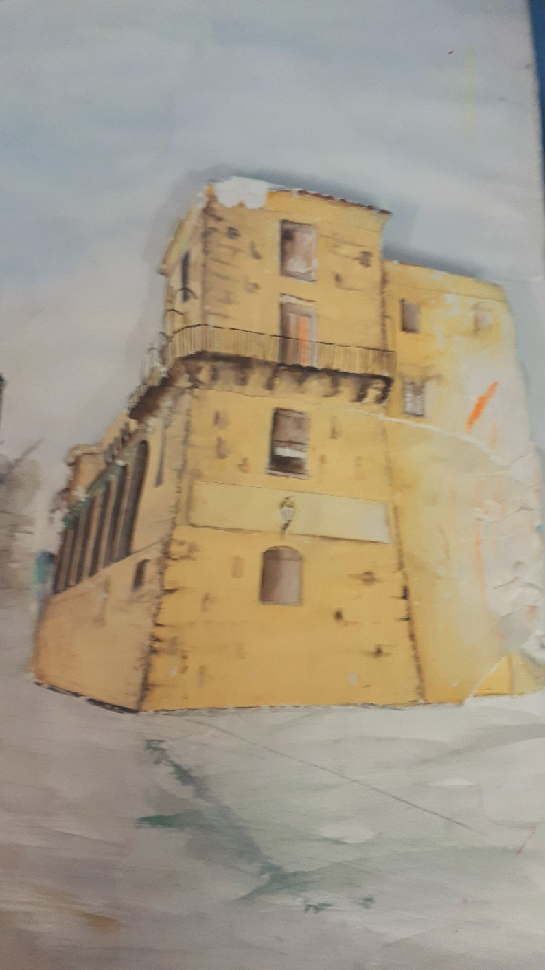
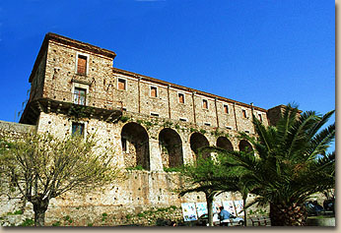
THE NORMAN CASTLE

Slide 9
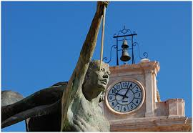
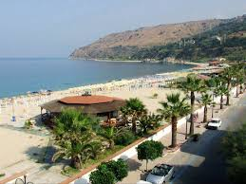
THE CLOCK TOWER
Nicotera Marina

Slide 10
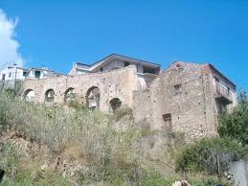
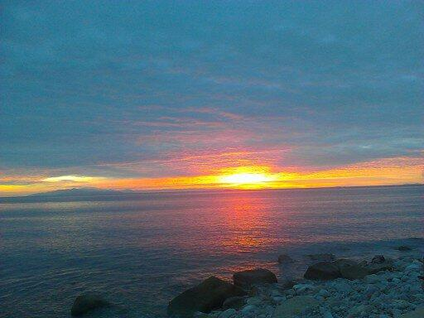
ANCIENT MILL
THE SUNSET

Slide 11
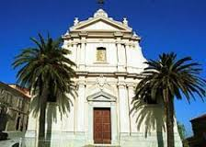
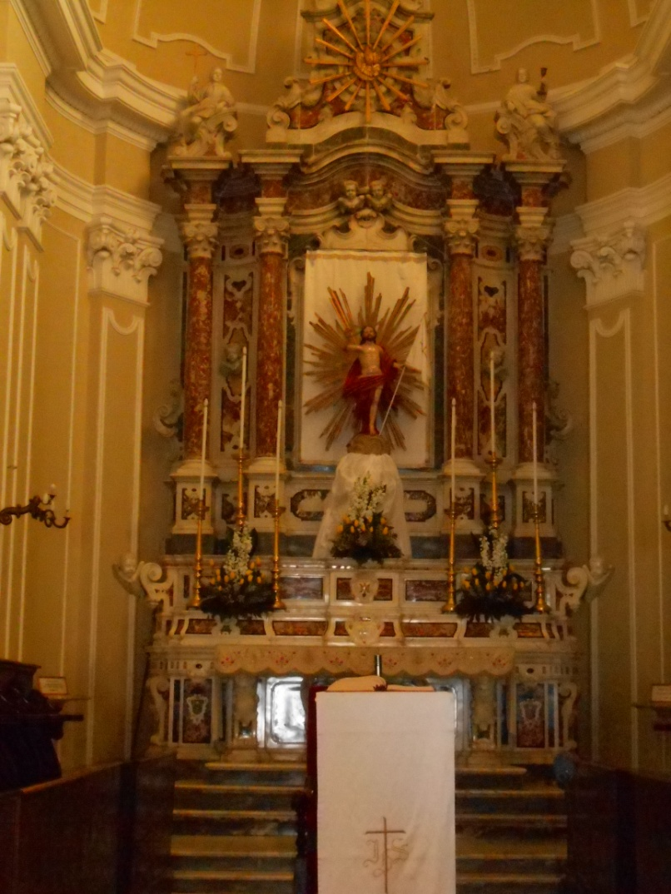
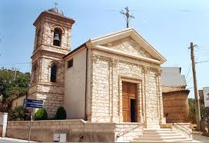
THE CHURCHES

Slide 12
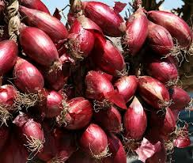
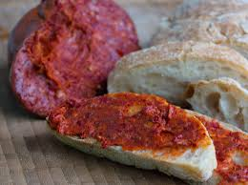
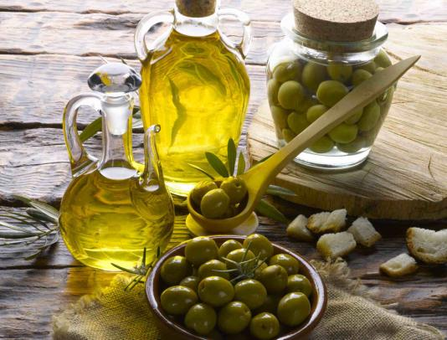
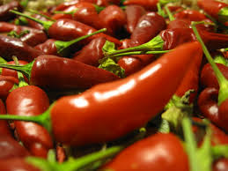
THE FOOD
Nicotera is the reference city of the Mediterranean Diet . In fact in Nicotera you eat well and in a healthy way; we eat a lot of fish, vegetables, cereals and we produce olive oil and good wine.

Slide 13
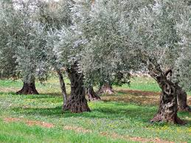
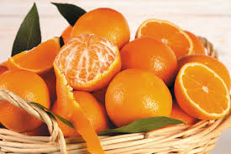
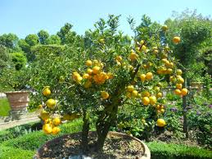
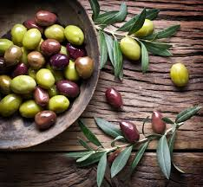

Slide 14
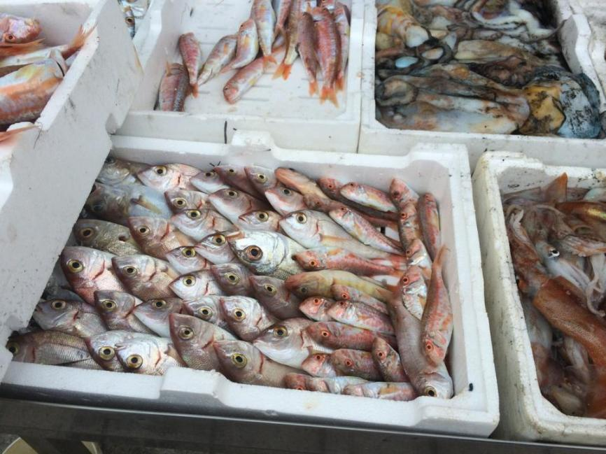
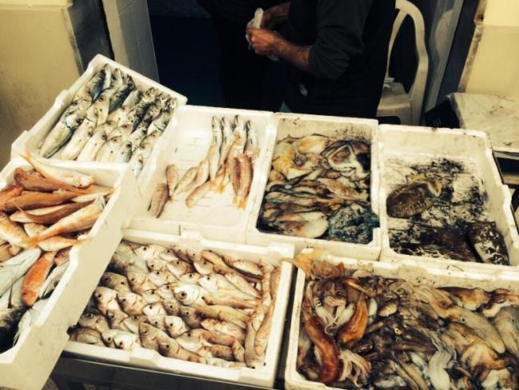
FRESH FISH

Slide 15
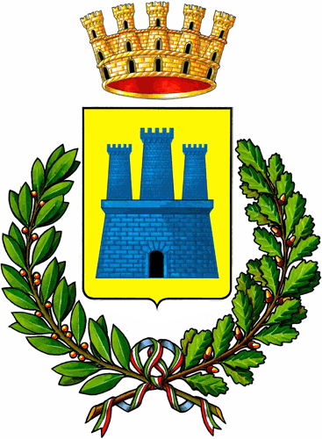
The logo of the town NICOTERA

