Slide 1
My Town
NICOTERA MARINA

Slide 2
PRIMARY SCHOOL
DON LORENZO MILANI
CLASS 2-3 ^

Slide 3
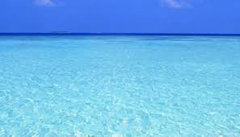
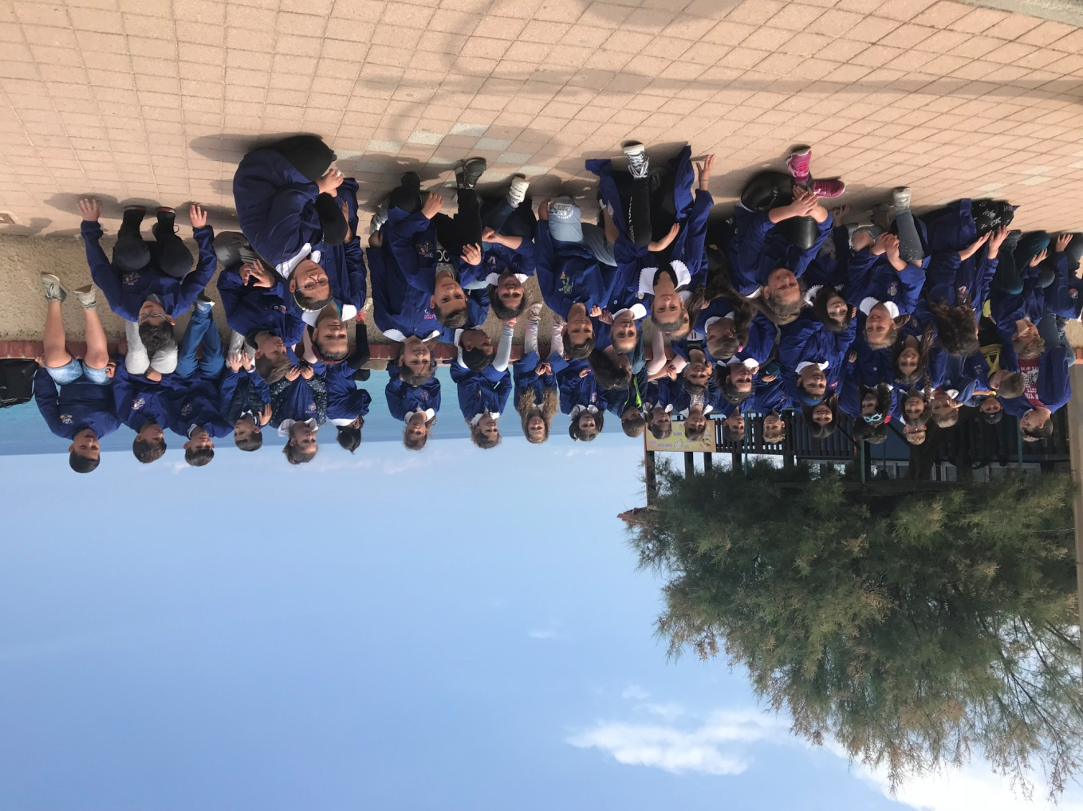
WELCOME TO NICOTERA MARINA
COME TO VISIT US !!!!!!

Slide 4

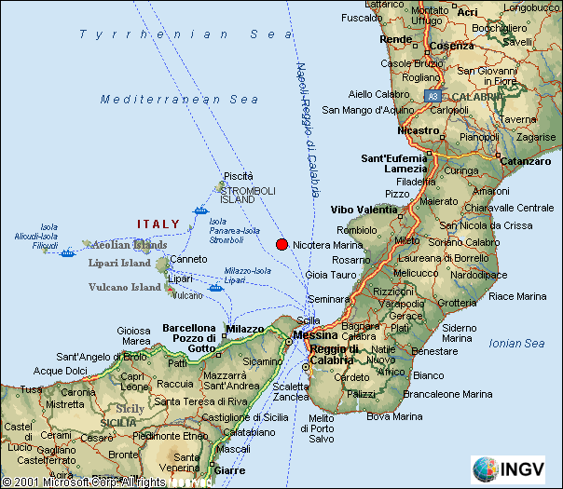
NICOTERA MARINA IS HERE
.....is the last village in the province of Vibo Valentia.

Slide 5

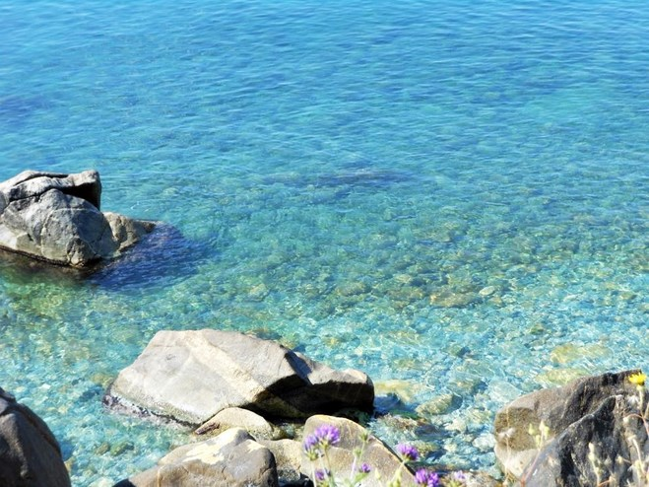
City of the Mediterranean diet ,from 2015 Nicotera wins the green flag on the beaches.
The Mediterranean diet is based on the consumption of fish, legumes, fruits, vegetables and wines.

Slide 6

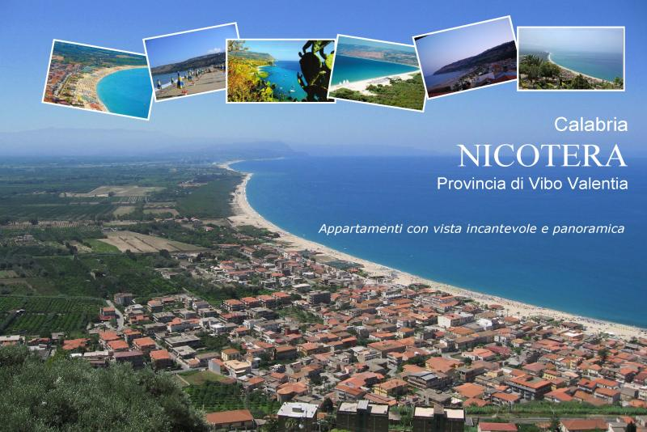
Nicotera has about 1300 people .

Slide 7
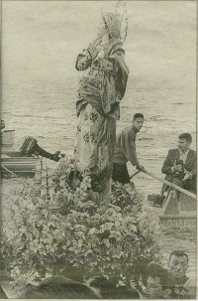
It is a very old town
In the 1819 a ship throw away many wood boxes, which contained some statue. There was the statue of the Immaculate Virgin Mary.

Slide 8
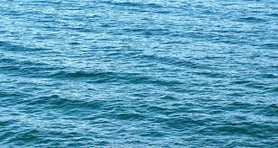
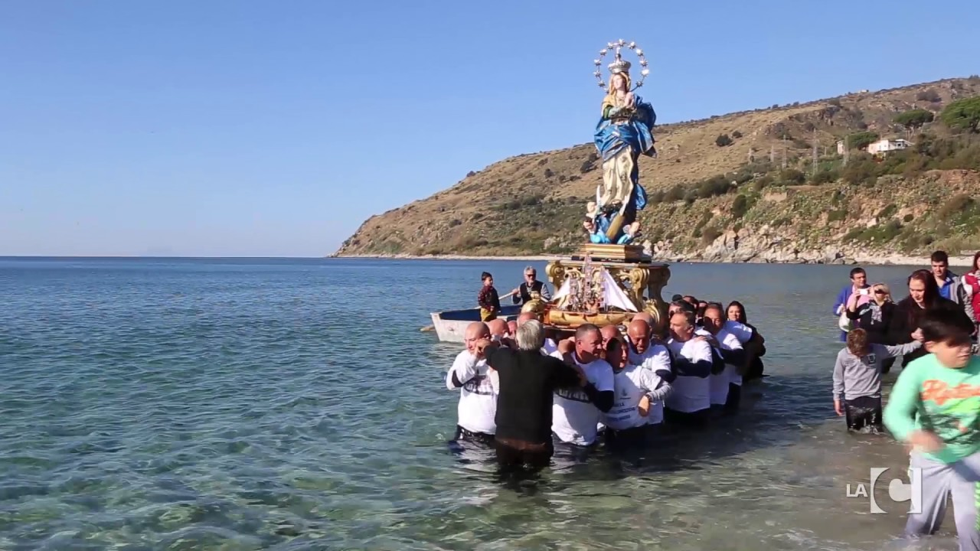
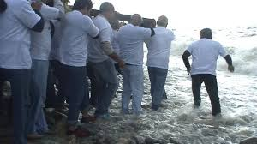
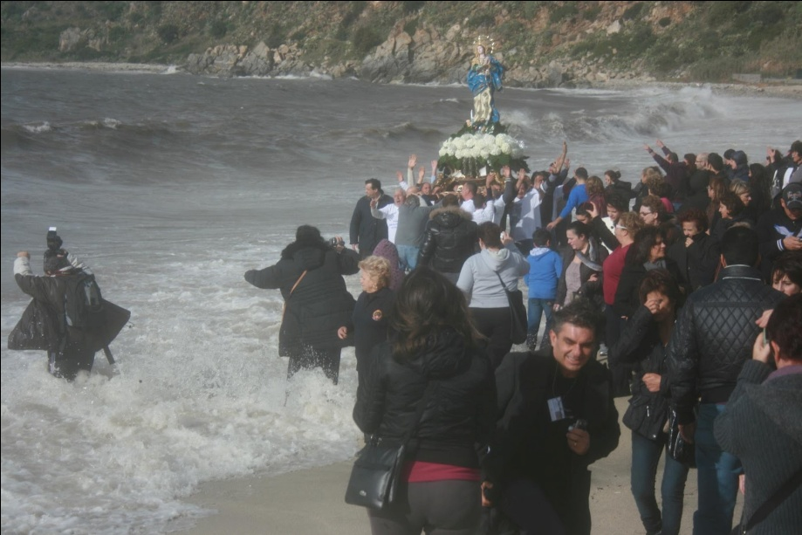

Slide 9
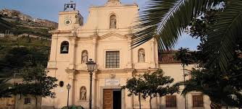
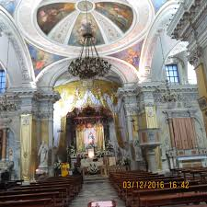
THE FAMOUS CHURCH : VIRGIN MARY IMMACULATE

Slide 10
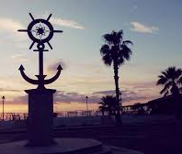
WIND ROSE
NICOTERA MARINA SYMBOL

Slide 11
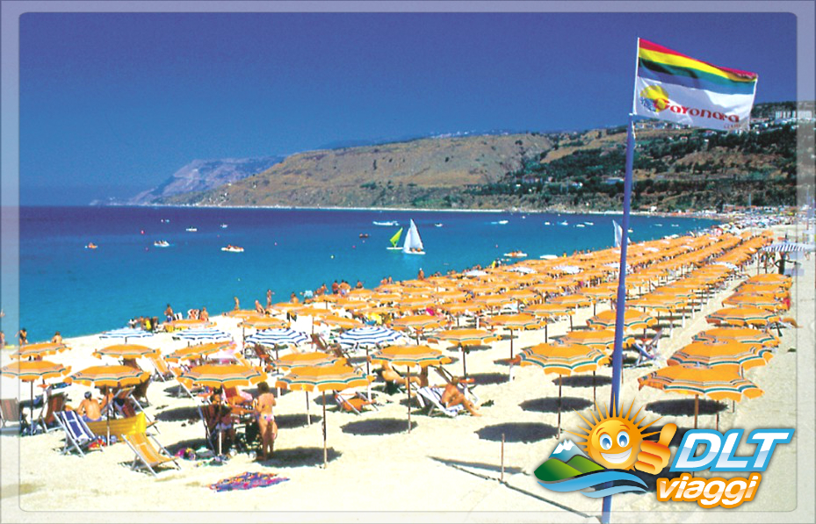
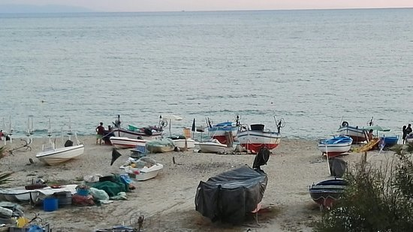
BEACH
SMALL FISHERMAN BOATS

